Slide 1
Working with SharePoint Content
Using HttpClient to talk to SharePoint

Slide 2
Agenda
How to talk to SharePoint
Co-existing with mock data
Important patterns to follow
Q&A

Slide 3
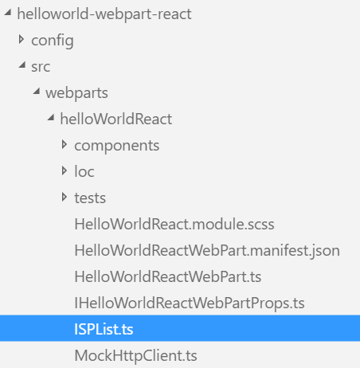
How to talk to SharePoint
Create a data model for the data
Reuse the same data model created for mock data
export interface ISPList {
Title: string;
Id: string;
}

Slide 4
How to talk to SharePoint
Import the data model into the web part class
Create a method to return the mock data
Use the SharePoint context SPHttpClient to call SharePoint REST APIs
import { ISPList } from './ISPList';
private _getSharePointListData(): Promise<ISPList[]> {
return this.context.
spHttpClient.get(this.context.pageContext.web.absoluteUrl +
`/_api/web/lists?$filter=Hidden eq false`, SPHttpClient.configurations.v1)
.then(response => {
return response.json();
})
.then(json => {
return json.value
}) as Promise<ISPList[]>;
}
Notes:
The _getSharePointListData method invokes the SharePoint REST API to return the SharePoint lists in the SharePoint site where the web part executes.

Slide 5
How to co-exist with mock data
Check the EnvironmentType to determine if the web part is running in the local environment
Invoke the method to return the mock data when running in the local environment
Invoke the method to call the SharePoint REST API when not running in the local environment
private _getListData(): Promise<ISPList[]> {
if(Environment.type === EnvironmentType.Local) {
return this._getMockListData();
}
else {
return this._getSharePointListData();
}
}
Notes:
The _getListData method determines what environment the web part is running in. It returns mock data when running in the local environment or it returns data from the SharePoint REST API when not running in the local environment.

Slide 6
Important patterns to follow
Use ETags to ensure data integrity when updating and deleting items
Chain promises when performing multiple asynchronous operations as part of one use case
Break a chain of promises in case of an error and handling it gracefully
Retrieve the List Item Entity Type to model items in REST requests
Optimize REST responses for performance
React
Use Office UI Fabric React components
Use state to keep track of Web Part status and data
Use the web part's HttpClient in a React component
Angular
Load Angular and ngOfficeUIFabric from CDN
Use conditional rendering for one-time web part setup
Pass web part configuration to Angular and react to configuration changes in the Angular application
SP PnP JS Library
Use the SP PnP JS library with SharePoint Framework Client-Side web parts
Configure global request headers and override them for specific requests, as needed
Sort and select the top n items from a list with the fluent API

Slide 7
DEMO
Using HttpClient to talk to SharePoint
Notes:
Use the Exercise 2: Using HttpClient to talk to SharePoint in the lab manual.

Slide 8
Summary
How to talk to SharePoint
Co-existing with mock data
Important patterns to follow
Q&A

Slide 9
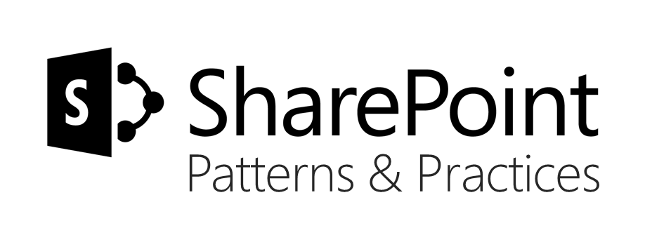
Sharing is caring…
Code samples and solutions
Reusable components
Guidance documentation
Monthly community calls
SharePoint Framework
SharePoint add-ins
Microsoft Graph
Office 365 APIs
http://aka.ms/SharePointPnP

Slide 10

Q&A

Slide 11


